Slide 1

Introduction to Stage Lighting
Kunwu Lyu
20240928
https://github.com/kwlyu/EOS-Training

Slide 2
Topics to Cover
Setup
Cue Writing Basics
Patch, Channel, Parameters, Groups, Cues, Playback, Update
Workspace Navigation
Display Layouts, Palettes and Presets, Direct Selects
Intro Effects
Macros, Fan and Offset, Effects
Show Control
Timecode Integration with REAPER and QLab

Slide 3
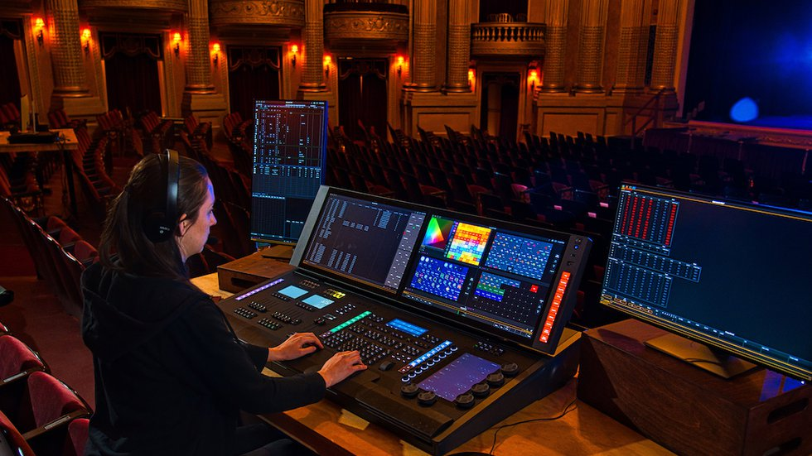
Goal
Give me something cool?

Slide 4
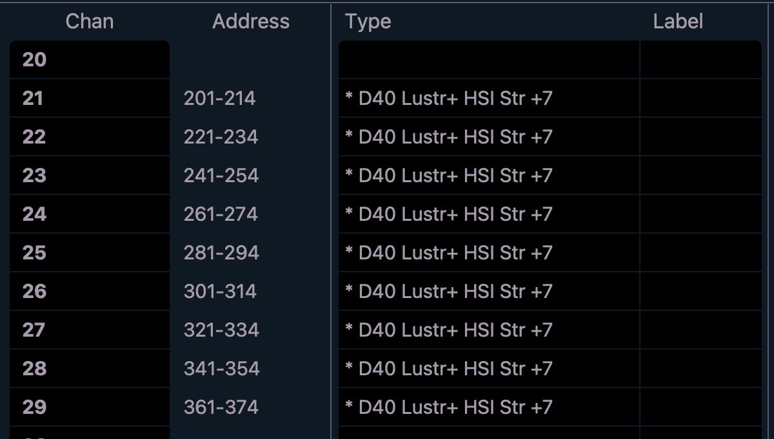
Patching
[21] [Thru] [29] [Enter]
Click on {Type} in the lower right hand corner of display
Click on {Search}
Find {ETC Fixtures} in left columns
Then {D40 Lustr+ HIS Str +7}

Slide 5
Channel vs Address
A channel can be
A dimmer
Multiple dimmers
Color-changing LEDs fixture
One Moving Light
A Source Four with a Color Scroller
An address can be
A dimmer
One parameter of a moving light
One parameter or color of an LED fixture

Slide 6
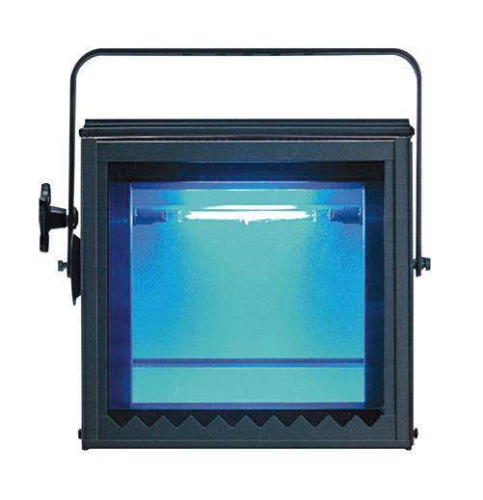
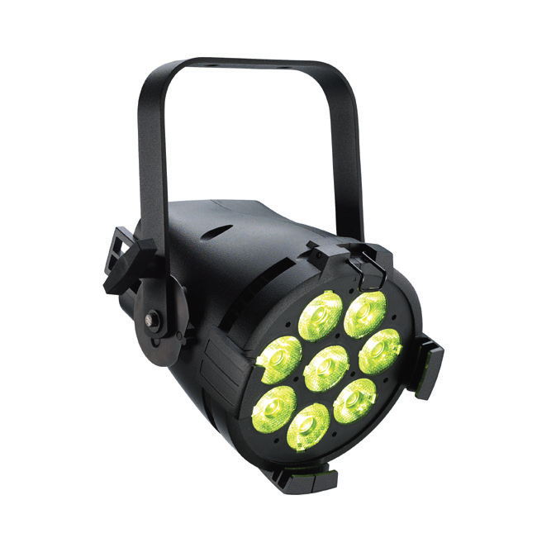
Types of Fixtures
FLOODLIGHT
Cover a large area at a relatively short throw distance. Lighting scenic cloths and cycloramas.
PAR
Create very bright, intense beams of light and can be used to create washes of color and striking beam effects.

Slide 7
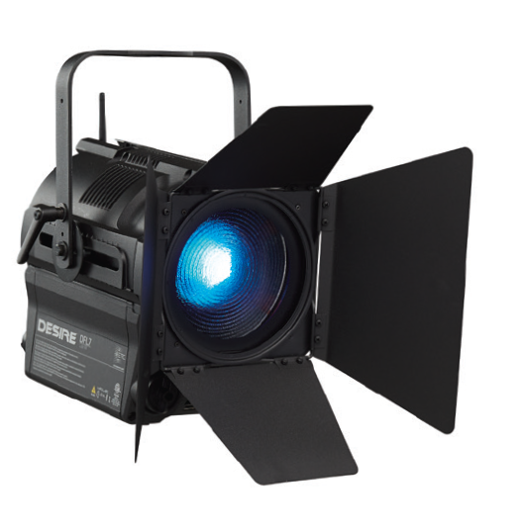
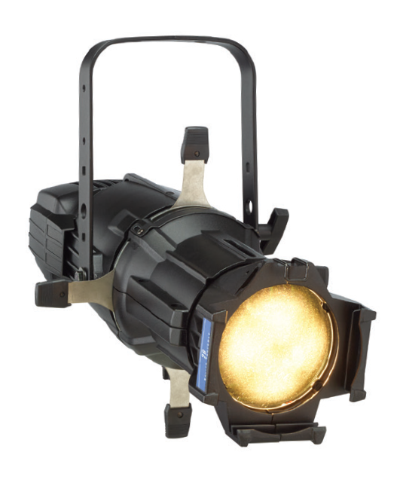
Types of Fixtures (cont.)
FRESNEL
Produce a soft-edged beam of light and can be used to create even washes of light on stage by adjusting the beam angle from a narrow spot to a wide flood. Using ‘barndoors’, you can also roughly shape and contain the light
PROFILE
Also called ‘Ellipsoidals.’ Available in a variety of beam angles, profiles are capable of projecting hard- or soft-edged beams of light and have a set of internal shutters that allow you to precisely shape the beam. They can also project patterns or ‘gobos’ to cast window projections or other textured effects. Followspots fall into this category

Slide 8
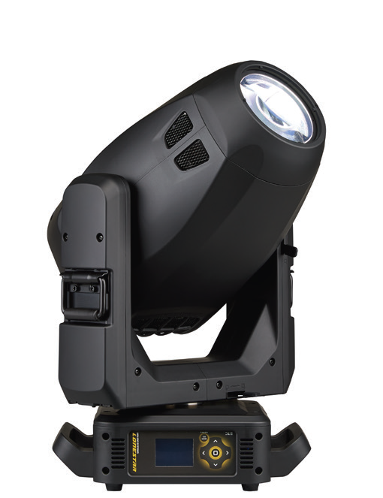
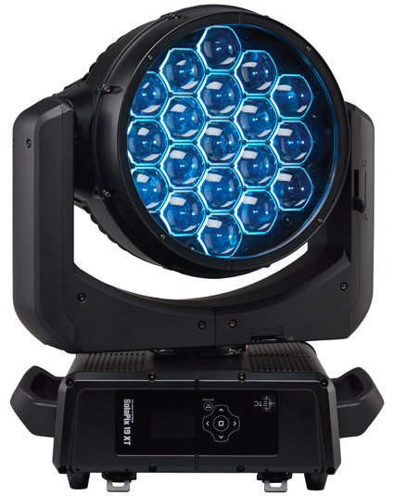
Types of Fixtures
MOVING LIGHTS
Moving lights are just automated versions of the above types of lights. Moving lights are typically broken down into two types – spots and washes. Wash lights are automated versions of the PAR or Fresnel, and Spots are automated versions of Profiles.

Slide 9
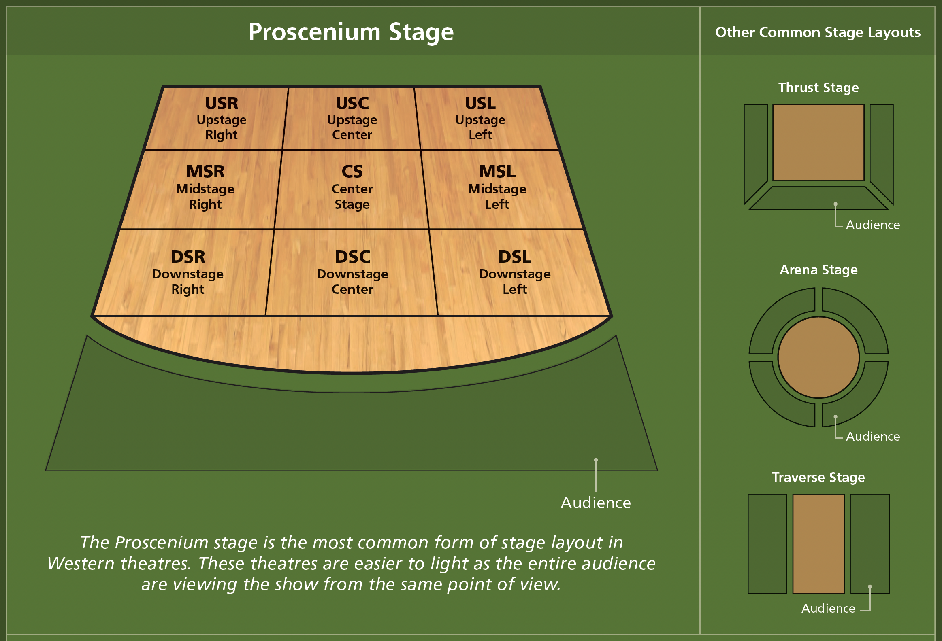
A Word on the Stage

Slide 10
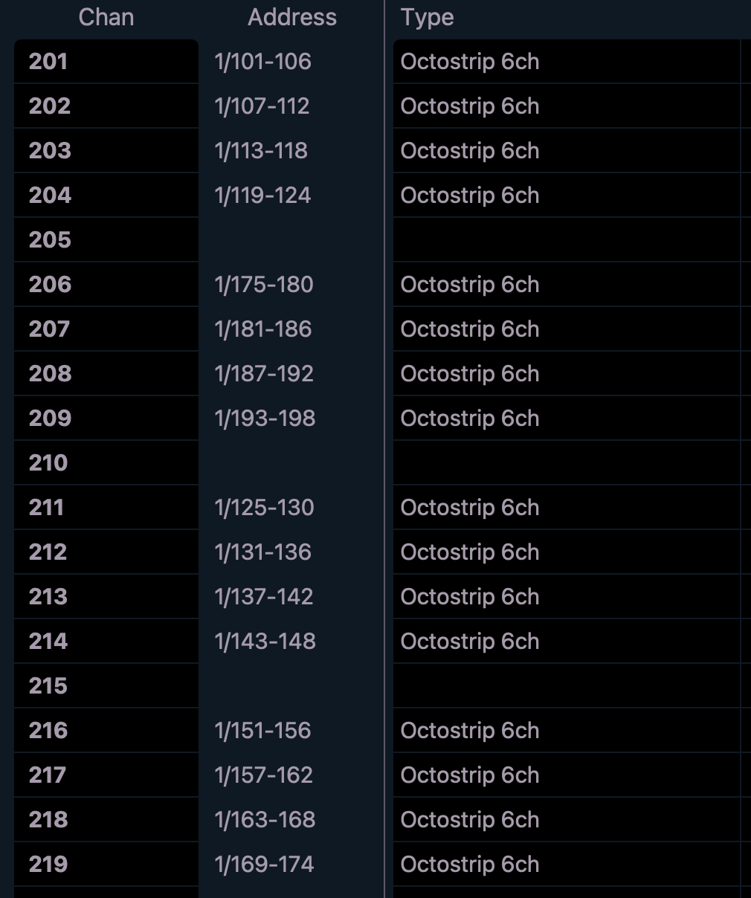
Patching Exercise

Slide 11
Channels in Live
Hold [Tab], Press [1], Release [Tab]
[201] [Thru] [219] [At] [5] [Enter]
sets level of 50% (use [05] for 5%)
[Clear] [Sneak] [Enter]
restores all manual levels to background states

Slide 12
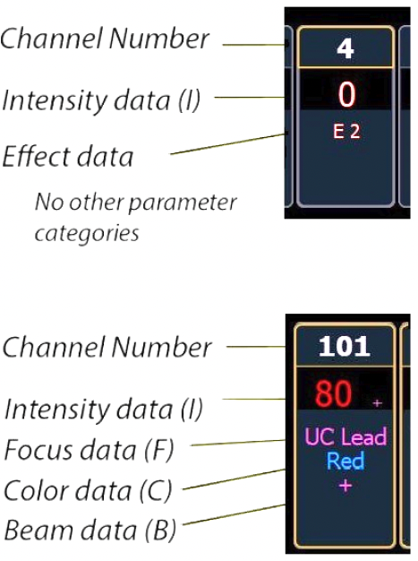
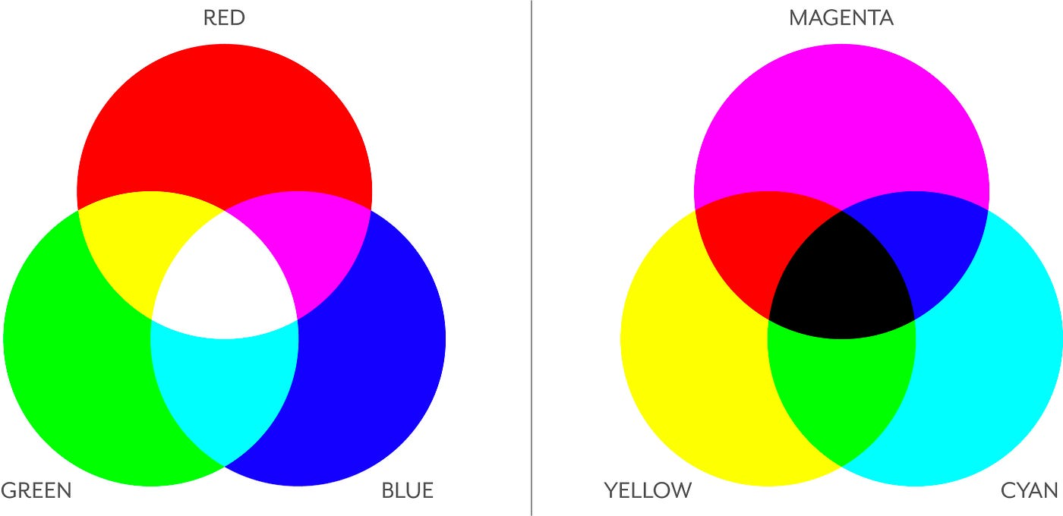
Parameters

Slide 13
Groups
A channel selection tool used for fast recall of specific channels
[21] [Thru] [29] [Record] [Group] [21] [Enter]
Records channels to the target group
[Group] [21] {Offset} {Mirror Out} [Record] [Group] [25] [Enter]
Using Offset to achieve center-out
[Group] [21] [At] [20] [Thru] [Full] [Enter]
Fanned intensity but in order this time

Slide 14
Cues
Single lighting looks that are stored in a list and often played back in order
[Clear] [Sneak] [Enter]
[Group] [200] [+] [91] [+] [21] [At] [5] [Enter]
[Select Last]
Select Color
[Record] [2] [Time] [3] [Enter]
[Label] B/O [Enter]

Slide 15
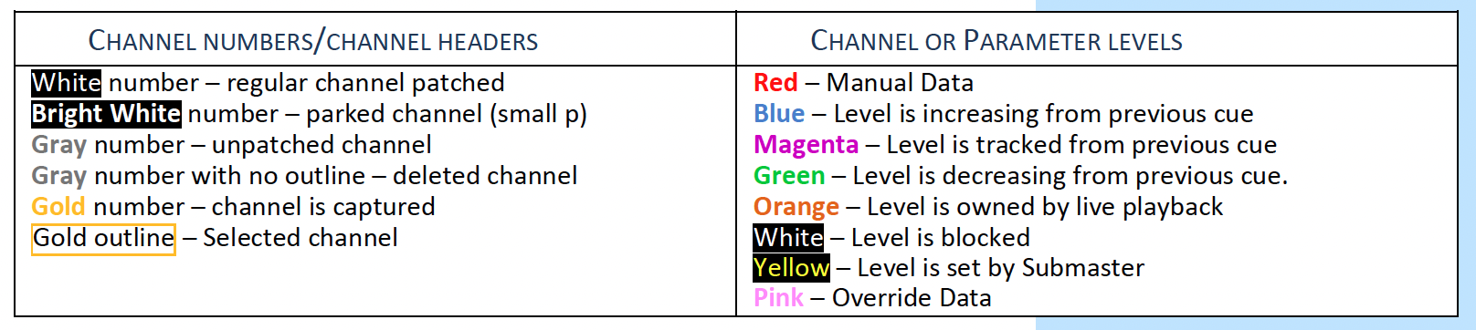
Color Conventions

Slide 16
Cue Writing Exercise #1
Make anything your Cue 3
It has to involve non-intensity parameters
Call it Stage Up

Slide 17
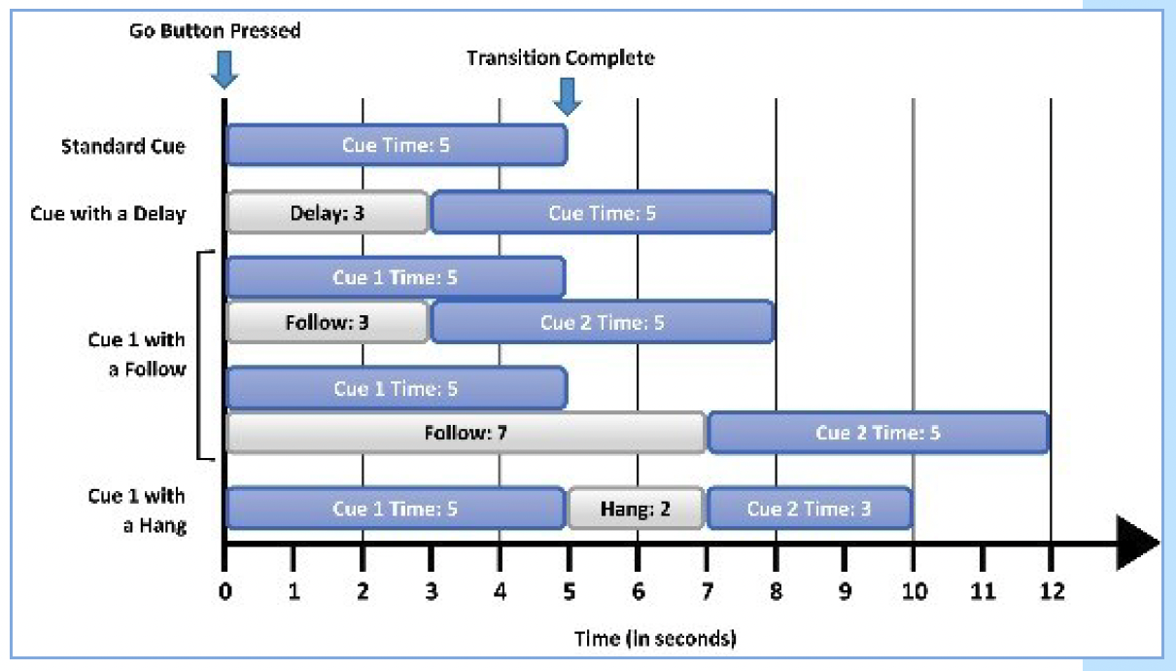
Cue Follow/Hang (Auto-Follows)
An auto-follow is when one cue automatically activates the next cue.
Follow time begins the moment the cue is executed (when the go button is pressed.)
Hang is similar but doesn’t start till the cue is complete.
{Fw/Hg} is a soft key; can also press [Shift] & [Delay] to access Follow and [Shift] & [Delay] [Delay] to access Hang

Slide 18
Cue Writing Exercise #2
Make a 2-step “Pulse” Cue with Follow/Hang

Slide 19
Playback
PSD is a tab that displays a list of the cues, their timing and additional information associated with the cues.
Press (Go)
Hold [Shift] and Press(Go)
Press (Stop/Back)
Hold [Shift] and Press(Stop/Back)
[Go To Cue] [3] [Enter]
[Go To Cue] [1] [Time] [1] [Enter]

Slide 20
Update
Update is a “save changes” tool. It only pertains to values that are red or modified – values that have been changed.
[Update] [Cue Only] [Enter]
Records without tracking

Slide 21
Display Layouts and Workspaces
Snapshots store layouts so that you can recall them quickly. They are stored in the show file, can be recalled on any device on the network.
[Record] [{Snapshot}] [3] [Enter]
[{Snapshot}] [3] [Enter]

Slide 22
Palettes
Four types of palettes that correspond with the four data categories – Intensity, Focus, Color, and Beam
[Group] [21] [Full] [Enter] {Color Picker} and select a red
[Select Last] [Record] [Color Palette] [21] [Label] Dk Red [Enter]

Slide 23
Presets --- All Palettes
Presets can collect all data for a given channel (intensity, focus, color, and beam palettes as well as absolute data) rather than just one parameter type like with a palette.
Fly In ----- Up (FP) and Off (IP) -> Down and On
Fly Out --- Down and Off -> Up and Off

Slide 24
Direct Selects

Slide 25
Macros
A Macro is an automated series of console actions. Macros are a way to automate repetitive, complex or hard-to-reach commands in the desk
[Macro] [Macro]
Macro Editor Display
[Learn] [4] [Enter] {Allow App Connections} [Learn]

Slide 26
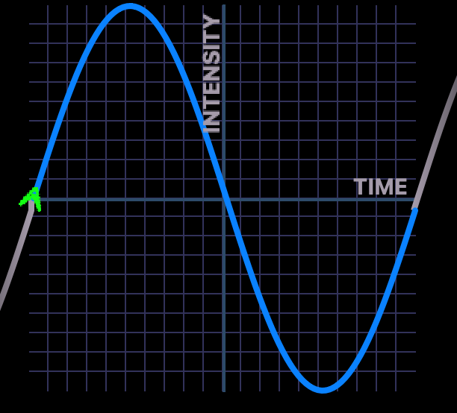
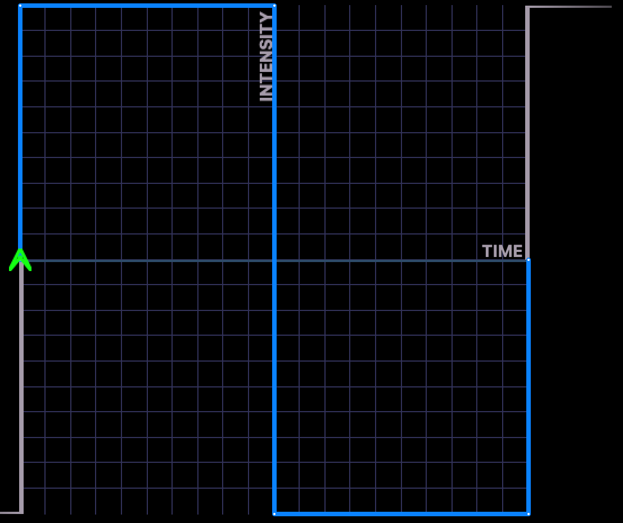
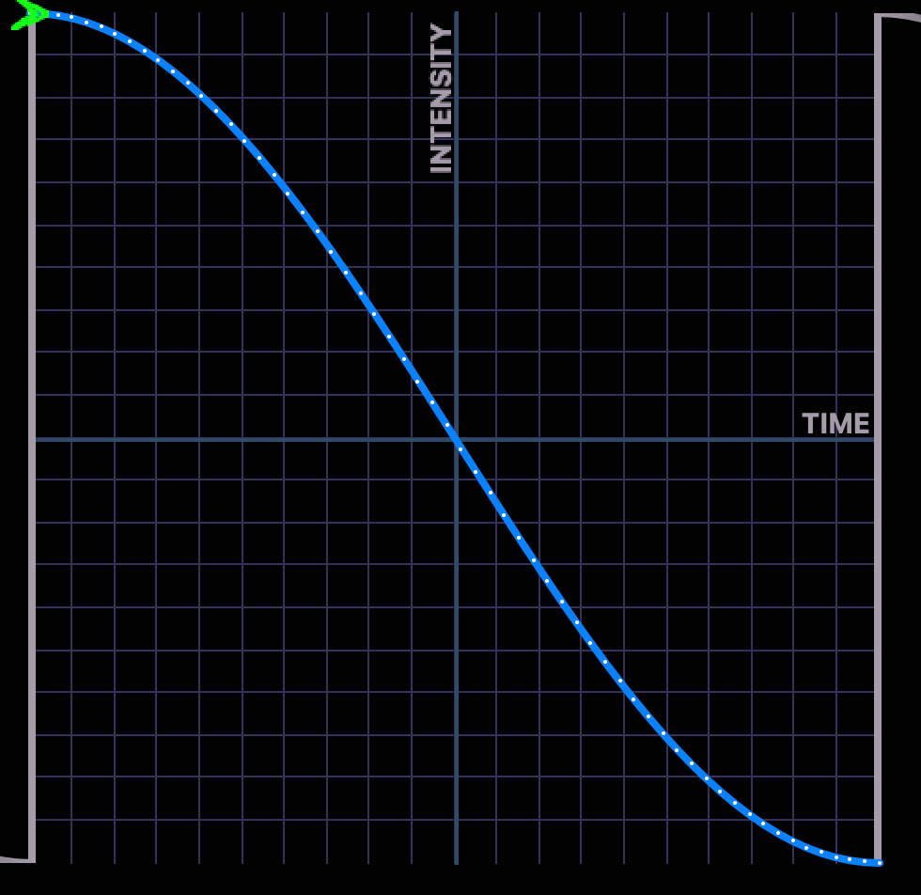
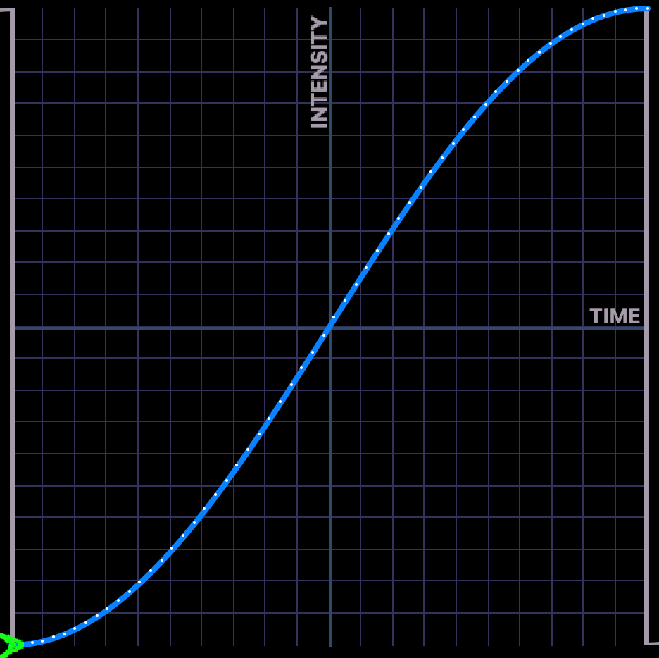
Effects!
Four Type of Basic Effects
Sine
Step
Burst
Ramp

Slide 27
A Word on Numbers

Slide 28
Timecode!
Show Control

